Slide 1
RPA Using Power Automate
Ashutosh Singh

Slide 2

Ashutosh Singh
Group Technical Manager
HCL Technologies
Ashutosh@80
ashutosh@sharepointworld.in

Slide 3
Session Agenda
RPA
Power Automate UI Flow
When and where to use UI Flow
Setting up environment

Slide 4
What is RPA
Software that can perform the actions of agents
An non-intrusive method for system integration, business rule execution, exception handling and data aggregation
2 types of robot:
• Attended
• Unattended

Slide 5
ATTENDED VS UNATTENDED robots
Unattended
A robot that runs in a server room
Attended
A robot that runs on a users desktop –
One robot per virtual desktop
100% automation
Fully documented processes
Back office operations
one robot per user
Useful for automation of repetitive tasks
< 100% automation
Partially documented processes
Front office operations´

Slide 6
UI Flow
Robotic Process Automation (RPA) capability that is added to Power Automate
Targeted to automate repetitive tasks on Windows and/or Web based applications
Designed to work with applications that don’t provide necessary API to be called
Storing the automation script in a secure cloud environment
Integrating the UI-based automation with the API-based automation
Currently in Preview, expected to be in General Availability in the first half of 2020

Slide 7
Demo

Slide 8
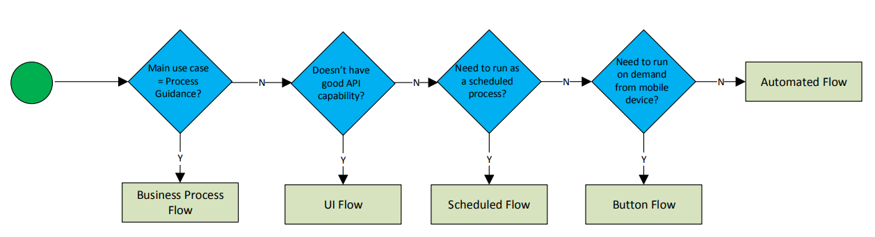
When to use UI Flow
From my opinion, this is the decision process in deciding the feature of the Power Automate capabilities:

Slide 9

UI FLOW IN DETAILED VIEW
There are 2 supported “interfaces” for the UI Flow:
Desktop applications in Windows – Compatible with Windows 10, Windows Server 2016, or Windows Server 2019 machines running 64-bit operating systems.
Web sites / applications – Compatible with web sites in the next version of Microsoft Edge (based on Chromium) or Google Chrome.
What’s under the hood?
Desktop: Windows UI Automation: https://docs.microsoft.com/enau/dotnet/framework/ui-automation/ui-automation-overview
• Web: Selenium: https://www.seleniumhq.org/

Slide 10

UI Flow Execution Model
There are 2 different ways of the RPA/UI Flow is run:
Attended automation is when the flow runs inside an existing user’s session on their PC.
Useful to automate ad-hoc repetitive tasks.
Unattended automation is when the flow runs on a separate machine that does not have a user logged in. [Currently in private preview]
Useful for fully automated tasks.

Slide 11
UI Flow Setup
OS: Windows 10, Windows Server 2016 or 2019
Browser: Google Chrome, Microsoft Edge (Chromium based)
Power Automate plan + CDS instance
Install UI Flow via the Installer
Activate the Browser Extension
Install Selenium IDE
Install on-premise Data Gateway (optional for actual deployment)

Slide 12
Demo 2

Slide 13
Any Questions?

Slide 14

Please fill out the survey! & Win Swags!!
https://www.powerplatformbootcamp.com/survey

Slide 15
Thank You For Attending

